Slide 1

Abhay Tiwari
Dashboards

Slide 2
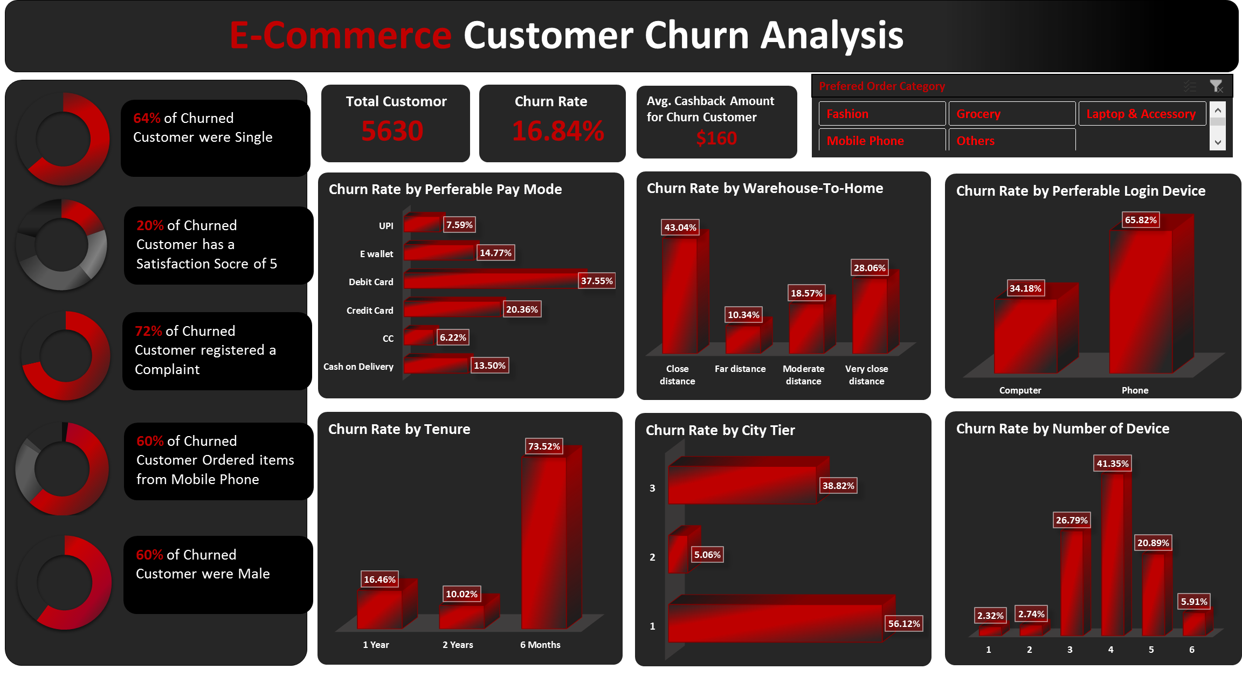

Slide 3
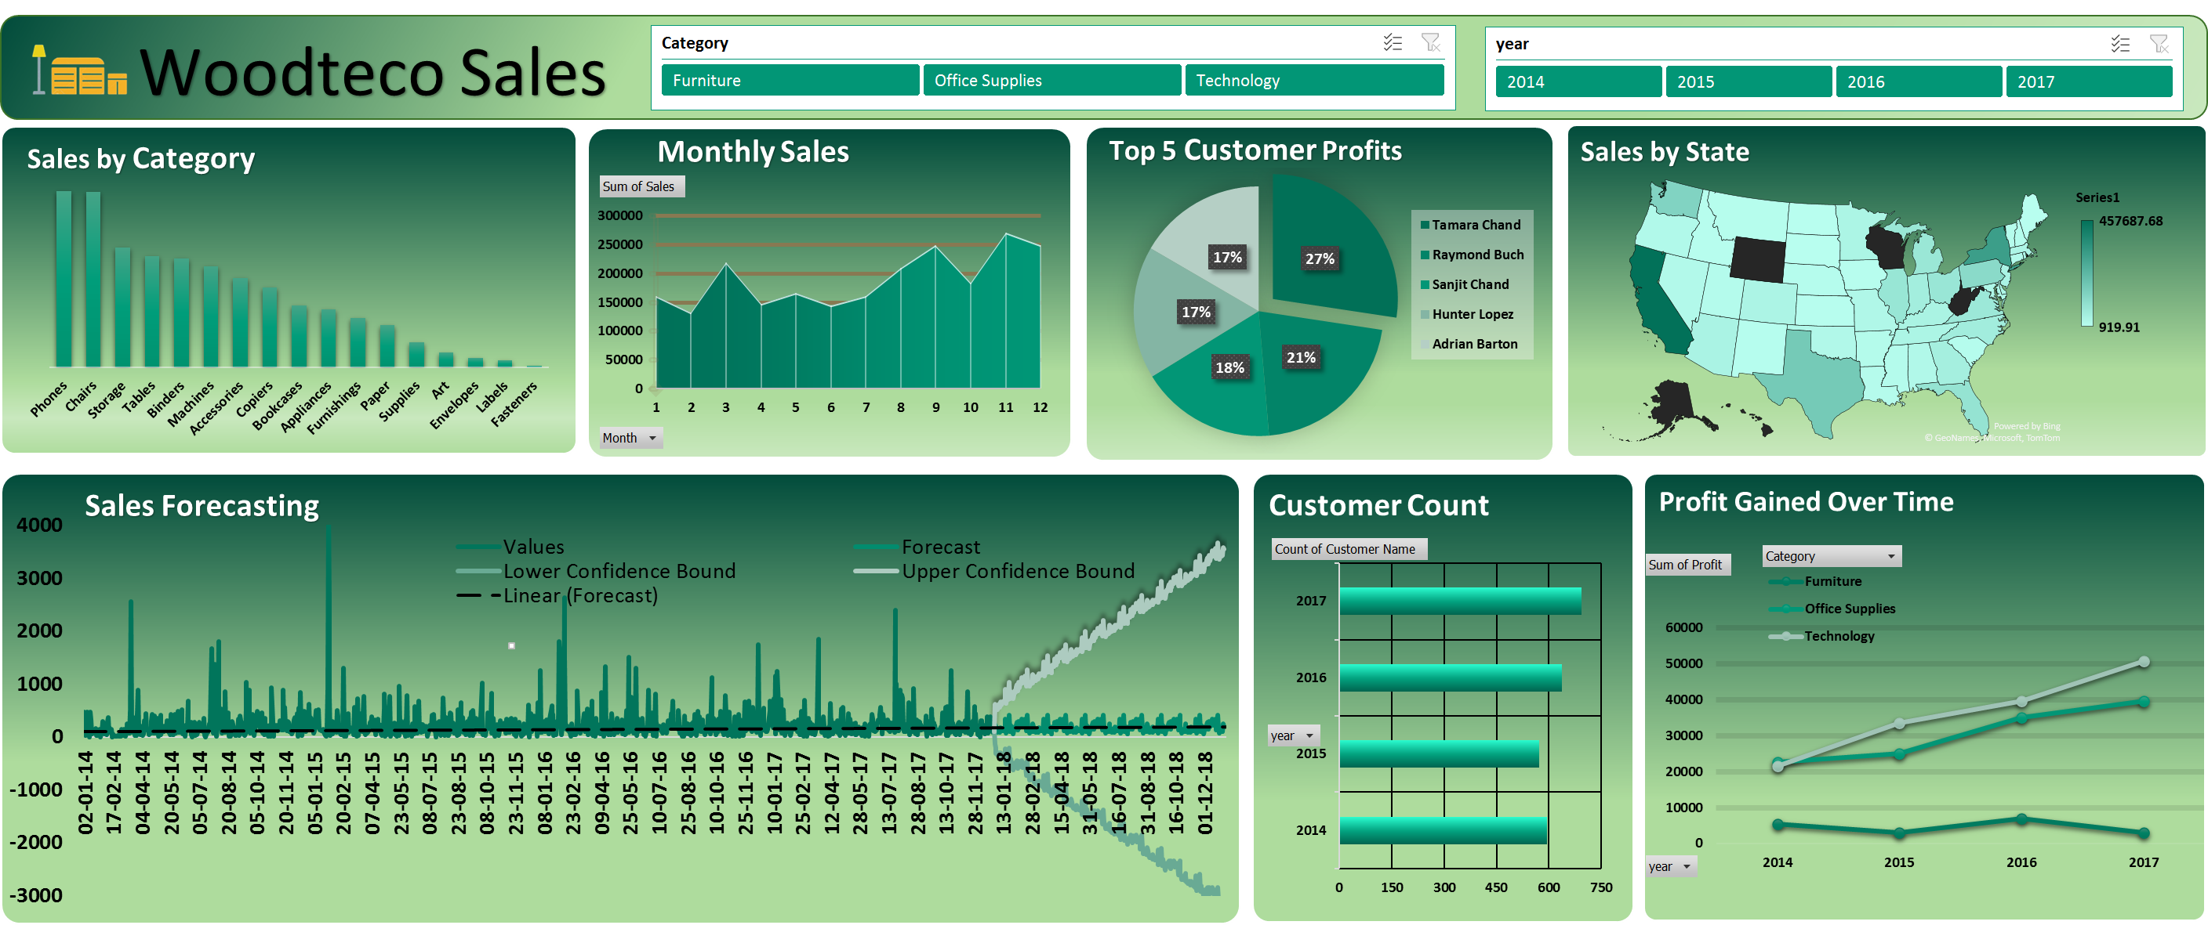

Slide 4
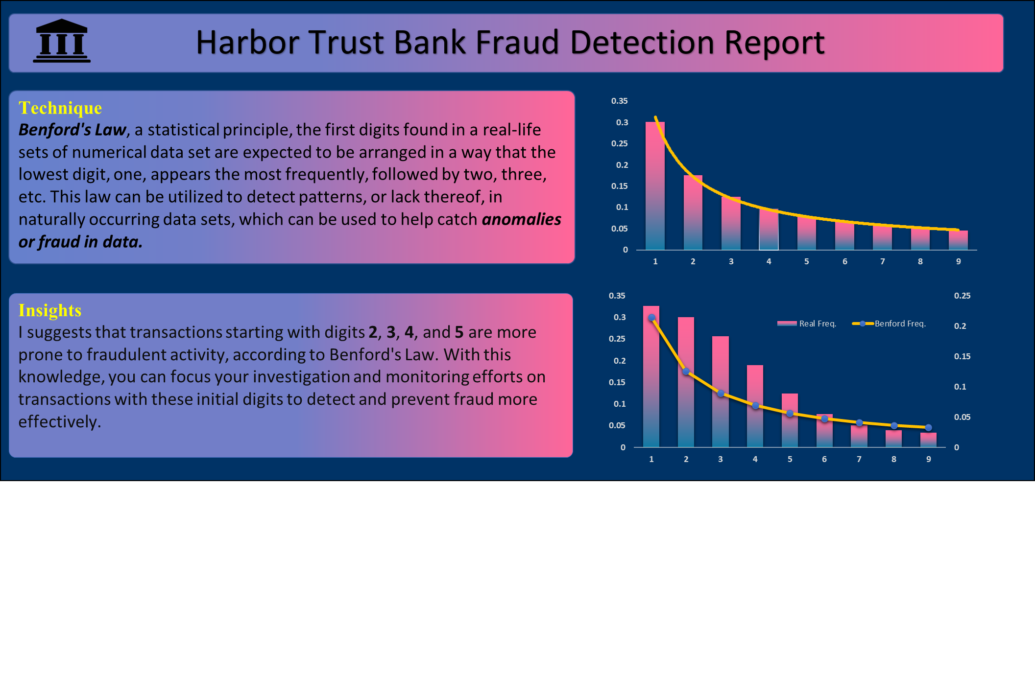

Slide 5
